Slide 1
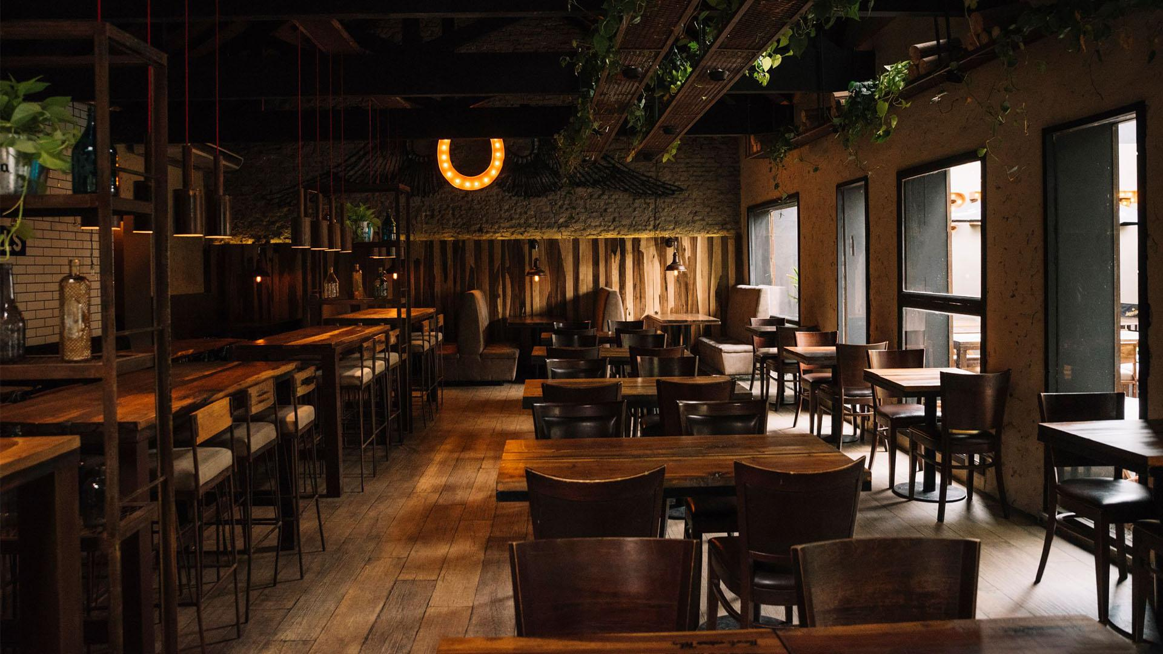
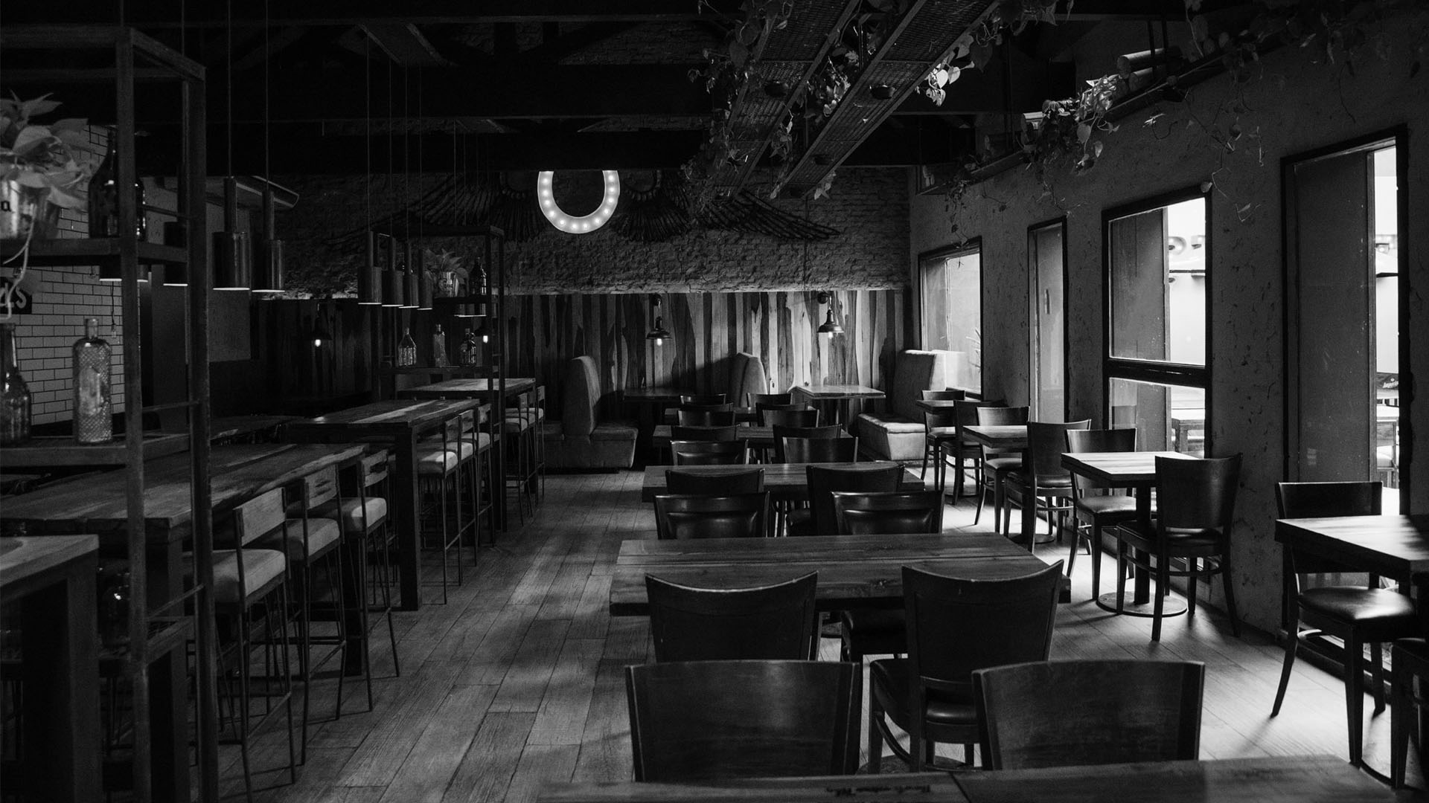
RESTAURANT DIGITAL MARKETING SOLUTION
GROUP - 1

Slide 2
TABLE OF CONTENTS
01
02
03
04
GENERAL DESCRIPTION
TARGET AUDIANCE
PROBLEMS & OPPORTUNITIES
BASIC FUNCTIONALITY

Slide 3
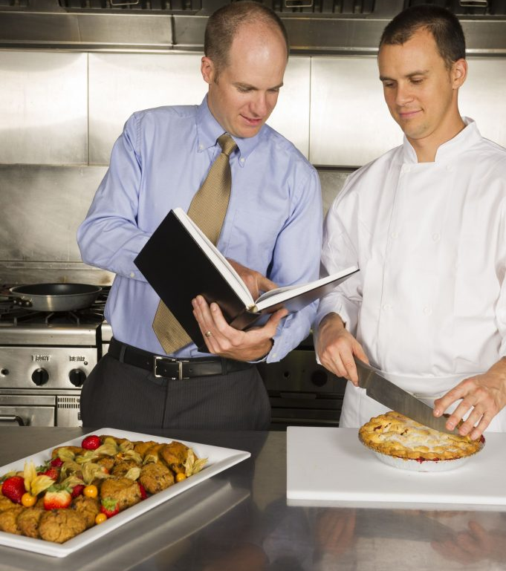
01
GENERAL DESCRIPTION
Consulting and giving proper elements and plan about marketing digitally.

Slide 4
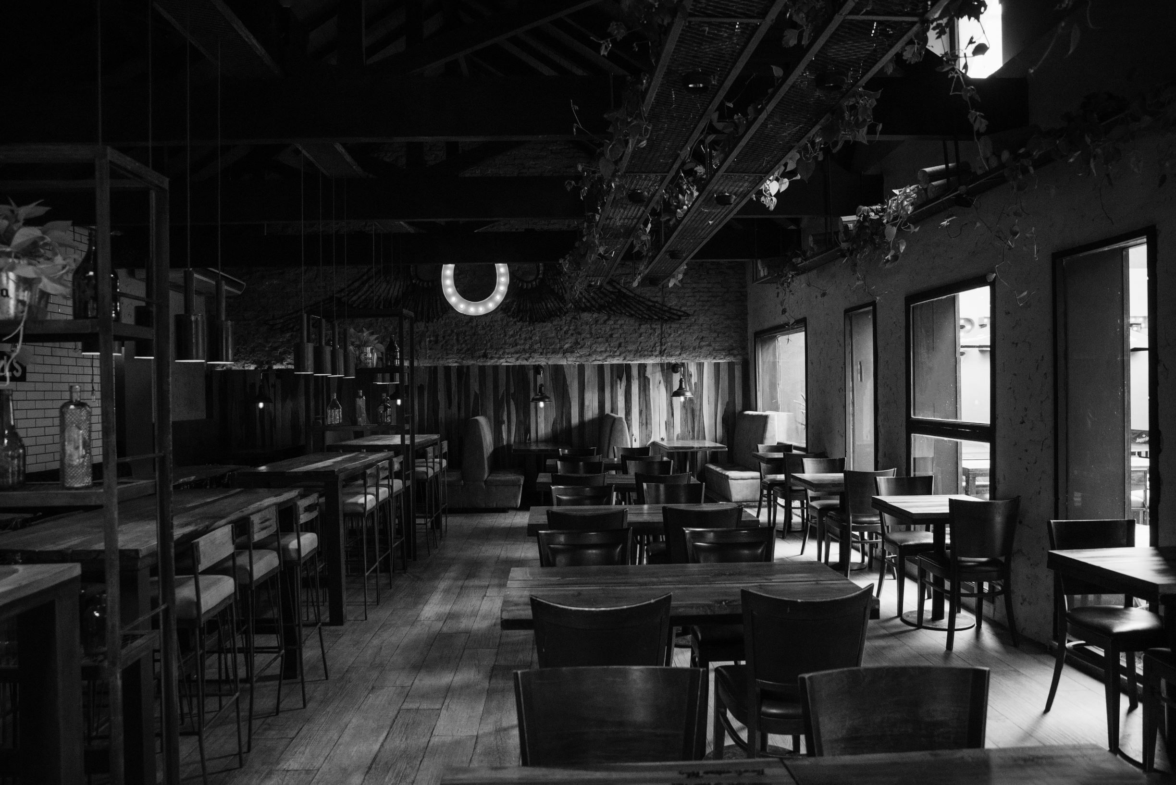
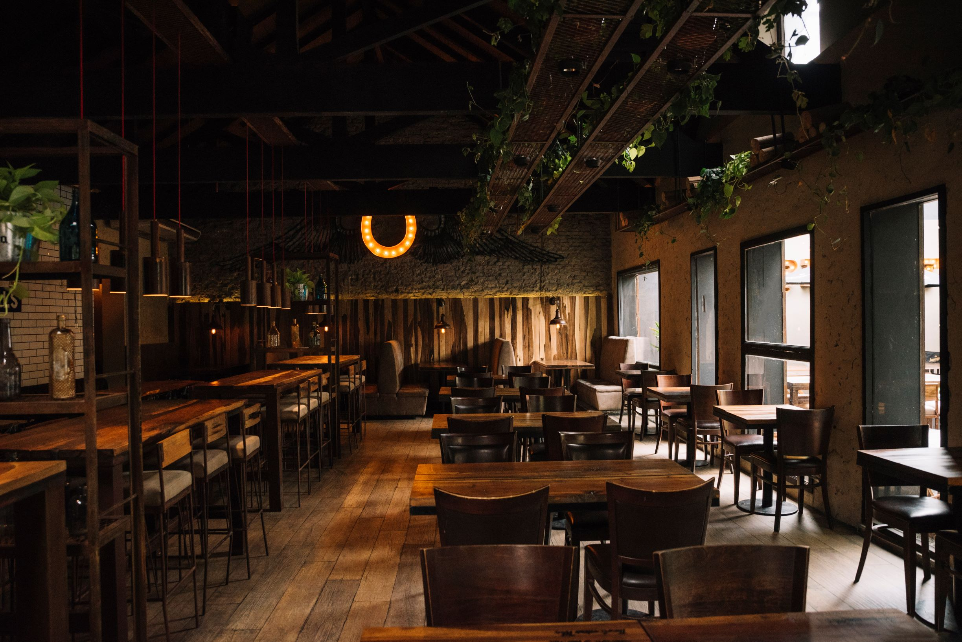
TARGET AUDIANCE
02
The intended audience for the software will be restaurant owners who are not sure what should be the best marketing decision for the restaurant.

Slide 5
03. PROBLEMS & OPPORTUNITIES
PROBLEMS
OPPORTUNITIES
People are not used to this kind of plan in Bangladesh region
Overcome the issue with the possible best and realistic solution

Slide 6
04. BASIC FUNCTIONALITY
DESIGN
ADVERTISING
i. Logo
ii. Website
iii. Interior
iv. Menu
i. Social Media Advertisement
ii. E-mail Advertisement
iii. Affiliate Marketing

Slide 7
THANK YOU

